Slide 1
Predicting House Prices in Ames, Iowa:
More features than you can handle
Jeremy Osir
NYCDSA
Winter 2022

Slide 2
Agenda
Project Overview
Exploratory data analysis
Pre-processing and feature engineering
Model Evaluation
Insights and Further Research

Slide 3
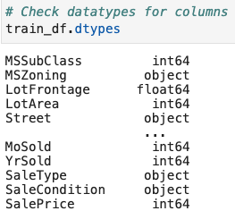
Project Overview
Context
Dataset features 80 variables describing various aspects of residential homes, and their sale price.
Objective is to train models that accurately predict house prices based on the explanatory variables.
Key Challenges:
Large number of explanatory variables
Mixed data types (certain machine learning models don’t do well with categorical data)

Slide 4
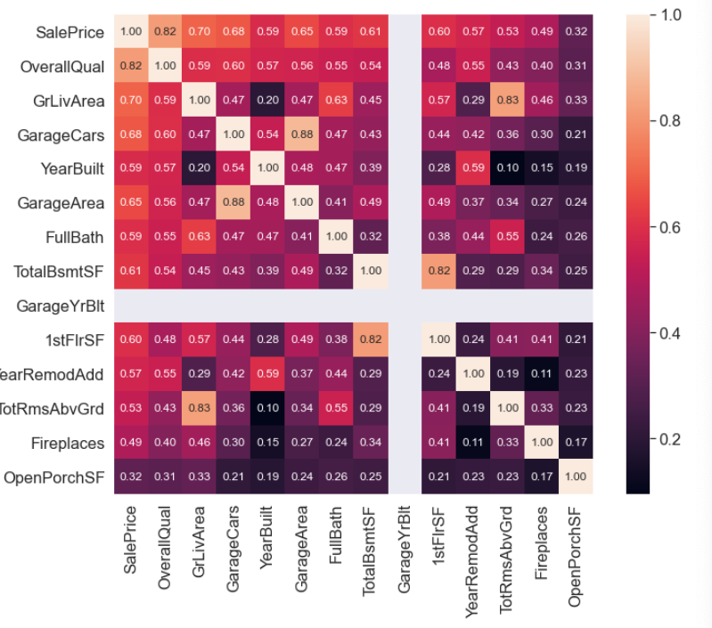
Observing feature correlation with SalePrice
Very light and Very dark shaded areas denote higher correlation. A few examples:
(GarageYrBlt, YearBlt): seems intuitive that these would be the same
(GrLivArea, TotRmsAbvGrd) : the more rooms the larger the area, generally
(BsmntUnitSF, BsmtFullBath): full baths tend to require more space
(OverallCond, YearBuilt): 'newer' homes would be in better condition than older homes
The features with the highest corelations with SalePrice:
high +ve corelations (> 0.7) : "OverallQual", "GrLivArea", "GarageCars", "YearBuilt"
moderate +ve correlations (0.5 - 0.7): "GarageArea", "TotBsmtSF", "1stFlrSF", "FullBath, "TotalRmsAbvGrd", "GarageYrBlt", "YearRemodAdd", "Fireplaces", "OpenPorchSF, "LotArea"

Slide 5
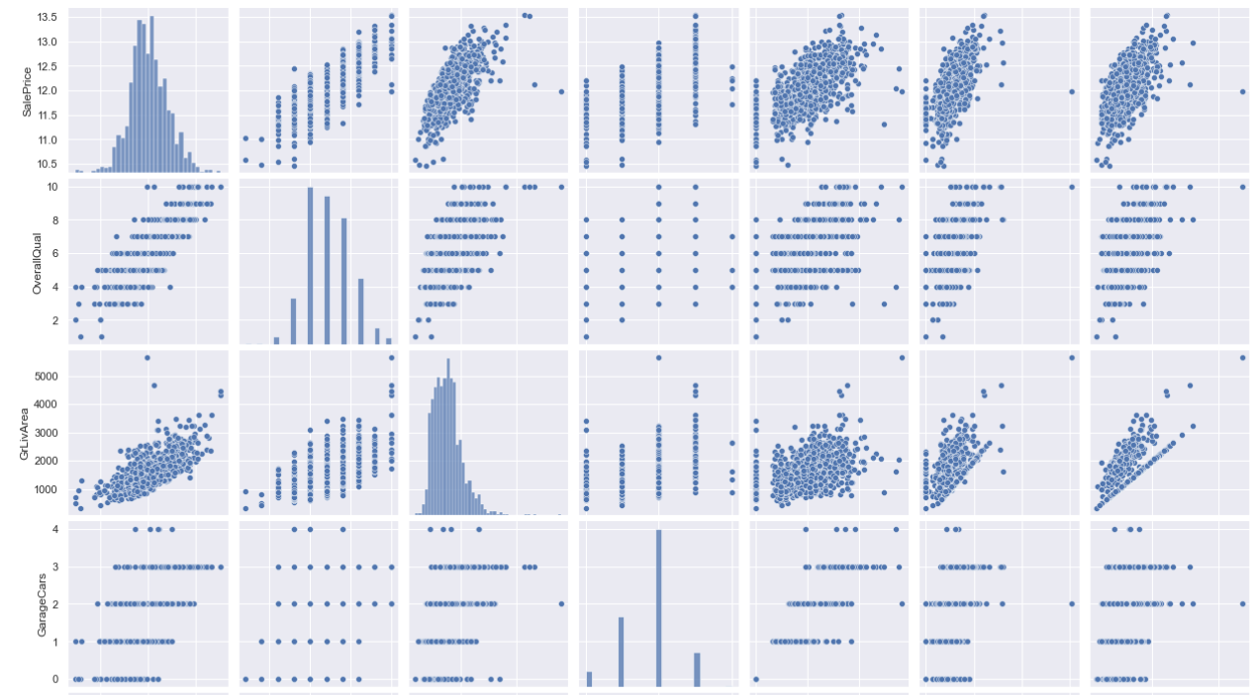
Data Pre-Processing
Check for outliers
Check for missingness
Check for normality
Feature engineering
Pairwise plot examining relationship between features

Slide 6
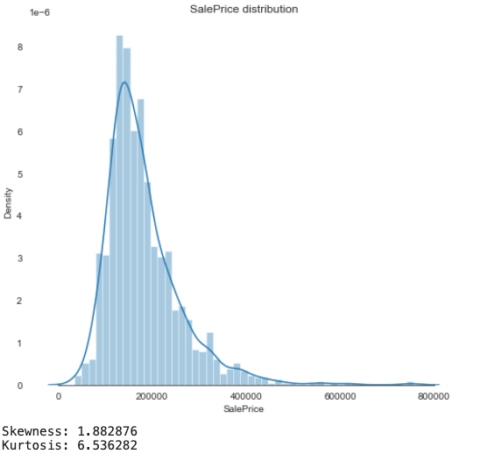
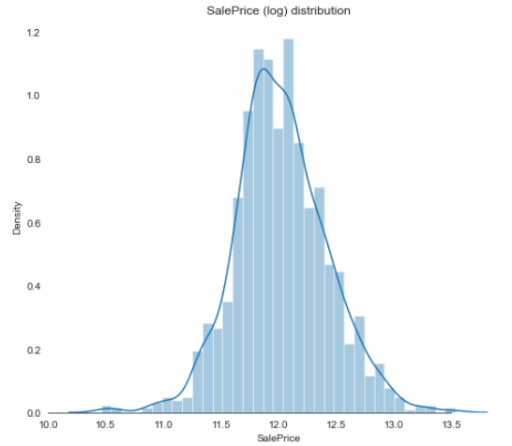
Normality: Log transform skewed features
Several common algorithms require that the input data meet certain conditions (e.g. normal distribution, no multicollinearity, no missing data) in order to function correctly.
Notes:
Log transformed 29 numerical features that had skew >0.5

Slide 7
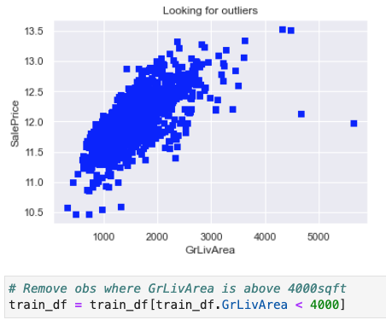
Outliers
In a paper presenting the Ames dataset, the author suggests removing observations where the “GrLivingArea” is greater than 4,000 sqft.

Slide 8
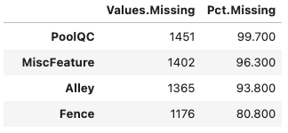
Removed features with more than 80% missing values
Notes:
We observe that 4 variables have over 80% of the values missing. **BAD**.
Looking closer, some possible reasons:
- PoolQC: many houses do not have pools (since they are a luxury).
- MiscFeature: according to the data dictionary, this could be "elevators, 2nd garage, sheds, tennis courts i.e. uncommon stuff.
- Alley: over 90% of houses in the dataset do not have alley access.
- Fence: over 80% do not have fences.

Slide 9
More pre-processing
Feature type conversion
Converted numerical features to categorical: MSSubClass, MoSold
Converted categorical variable to ordinal variables e.g. quality and condition
One-hot encoded categorical features
Remove “irrelevant” observations:
MSZoning: Deleted rows where house was listed in a “Commercial” zone.
SaleCondition: Deleted houses that were listed as “abnormal sales” e.g. foreclosures
Feature Engineering:
Consolidated square footage of porch variables into one feature ‘TotalPorchArea”
Consolidated number of bathrooms (full and half baths)
Calculated total square footage for home: ‘GrlIvArea’ + ‘TotalBsmtSF”

Slide 10
Model Evaluation

Slide 11
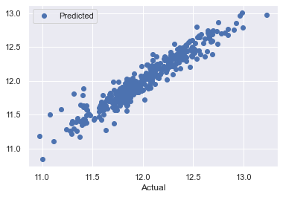
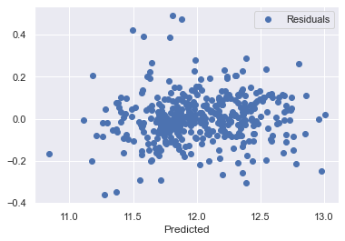
Linear Regression
OLS model had 95% accuracy on train set and 91% accuracy on test set, indicating some overfitting.
Solid predictive accuracy
No pattern in residuals, which is what we want

Slide 12
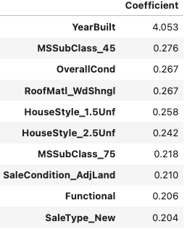
Top 10 linear regression coefficients

Slide 13
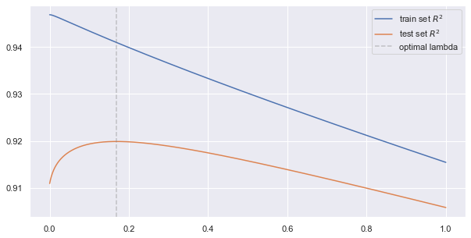
Models: Ridge
Evaluated model using various values for the hyperparameter (alpha: 0.00001 → 1)
Selected alpha where test R2 was highest [a = 0.169]
Train accuracy: 94%
Test Accuracy: 92%
Still some overfitting, but reduced compared to OLS

Slide 14
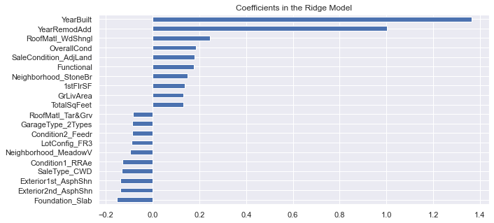
Ridge Features: Most important
Ridge picked 212 features and eliminated the other 9 features

Slide 15
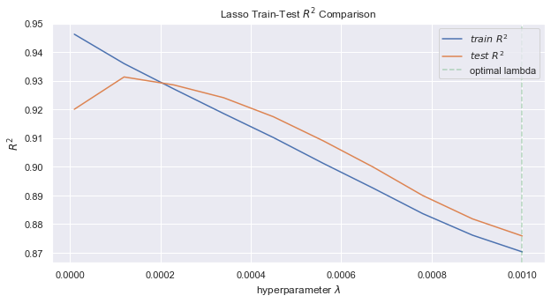
Models: Lasso
Evaluated model with various values for the hyperparameter (alpha: 0.00001 → 0.001)
Selected alpha where train R2 = test R2
Train accuracy: 94%
Test Accuracy: 93%
Still some overfitting, but reduced compared to OLS and Ridge

Slide 16
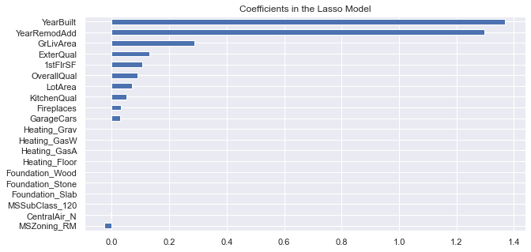
Lasso: Top Features
Lasso picked 15 features and eliminated the other 206 features

Slide 17
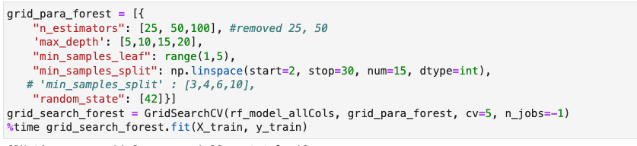
RandomForest, with gridsearch
Random Forest with default parameters had 98% Train Accuracy, but only 89% Test Accuracy
After tuning the RF parameters (depth of tree, num of estimators), accuracy did not change significantly – 97% train, 89% test

Slide 18
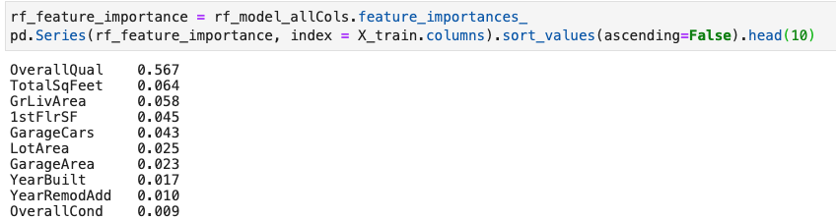
Random Forest: Top features

Slide 19
Evaluating Model Performance
Model | Train Accuracy | Test Accuracy
Linear Regression | 95% | 91%
Lasso | 94% | 93%
Ridge | 94% | 92%
Random Forest | 97% | 89%
Winner: Lasso Model had the lowest overfitting, and highest Test Accuracy.

Slide 20
Insights and Further Research
What we learned?
Features describing the house’s age, square footage, and quality/condition tended to have highest ‘importance’ when predicting sales price
Large number of features, and their non-normal distributions, highlighted importance of the pre-processing stage.
What next?
Evaluate other models e.g. ensemble, gradient boosting

